Slide 1
Auto Shade Device
Group 26: Molly Shay, Shilpi Ganguly, and Kelsey Lipman
Client: Dr. Frank Yin
December 4, 2015

Slide 2
General outline
Need, Scope, and Design Requirements
Overview of Design
Specific Details and Feasibility
Parts and Materials
Conclusions

Slide 3
Overview of need and scope
Low-cost, portable, shade device that automatically adjusts according to user preference to provide UV protection
High cost of current devices
Messy and toxic sunscreen
Requirement to manually adjust current techniques
Lack of accommodating features
Insufficient materials for UV protection
Lack of full coverage

Slide 4
DESIGN REQUIREMENTS
Attributes | Units | Specific Values | Notes
Temperature Range | Degrees C | -40 to 58
Cost
Low Cost | USD | < 200
Protection
UV Protective Material | UPF | > 30
Water Resistant |  | < 3% moisture regain
Light Weight
If Carried | kg | < 4.5
If Wheeled | kg | < 13.6
Easy to Use
Set up time | minutes | < 5
Extended periods of use | hours | > 8
Use on multiple types of terrain |  |  | be able to stand on grass, sand, and impenetrable surfaces
Wind Resistant | km/hr | > 64
Minimum Lifetime | years | 5
Shadow to fit 2 adults | meters | > 1.2 x 1.8
Minimum Height | meters | 1.12
Movement
Adjusting time | seconds | < 60
Sensors check shade periodically | minutes | 60
Solar powered
Notes:
Cover most relevant for this section- size, protection, weight
All components can withstand temperature range
Sensor time and adjusting time can be set in the coding

Slide 5
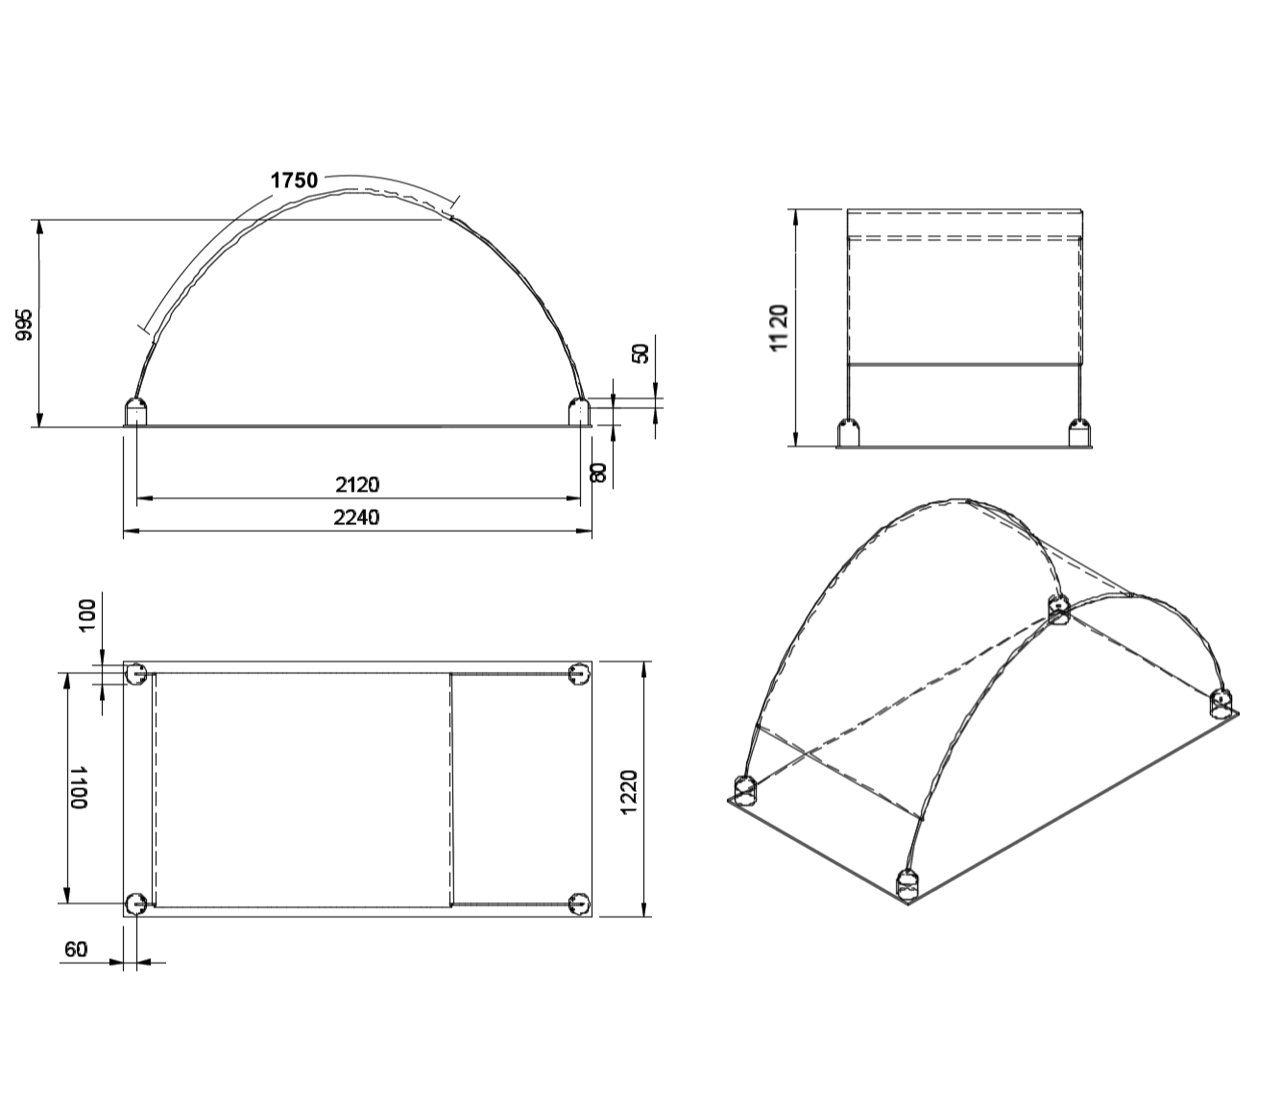
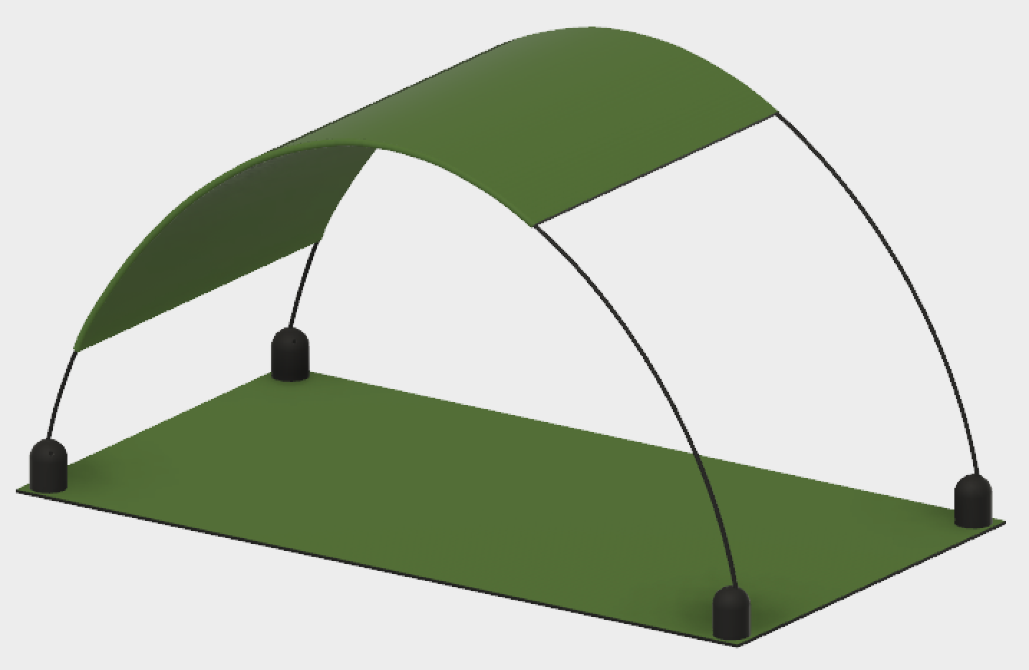
General Design

Slide 6
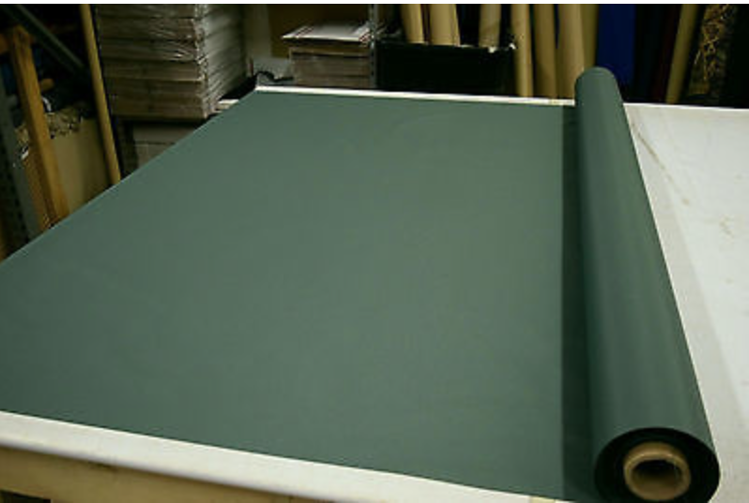
Fabric
Sun Dura Marine Awning Fabric
Marine Grade Polyester
Used for base material and shade
Inexpensive, lightweight, UV resistant, water repellent…
1-10 yards | $6.75 per yard
Availability | Now
Lead Time | 7 Days
Notes:
Polyester as chosen with pugh
B/c of water resistance requirement marine use polyester
Mention seams

Slide 7
Fabric Calculations
Fabric width of 58 in (1.4732 m), purchased per yard (1 yard = 0.9144 m)
Top Shade Dimensions including seams: 1.2962 x 1.75 m
Top Shade Surface Area: 1.296 ∗ 1.75 = 2.2792 𝑚²
1.75 m = 1.91 yards→ 2 yards must be purchased
Base Dimensions including seams: 1.2962 x 2.3162 m
2.3162 m = 2.533 yards → 3 yards must be purchased
Weight of Fabric 7 oz/yard = 0.237 kg/m²
Weight of Top Shade: 0.237 kg ∗ 2.2792 m² = 0.617 kg/m²
Total Weight: 0.237 kg ∗ (2.2792 + 2.533) m² = 1.314 kg/m²
Maximum Weight of Device if Carried: 4.54 kg
Maximum Weight of Device if Wheeled: 13.6 kg
Percent of Total Weight if Carried 1.314 ÷ 4.54 ∗ 100 = 29%
Percent of Total Weight if Wheeled 1.314 ÷13.6 ∗100= 9.6%
Notes:
1.296<1.4732 which is width of sold fabric so only how much ordered depends on the length

Slide 8
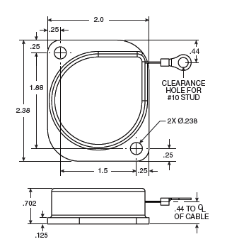
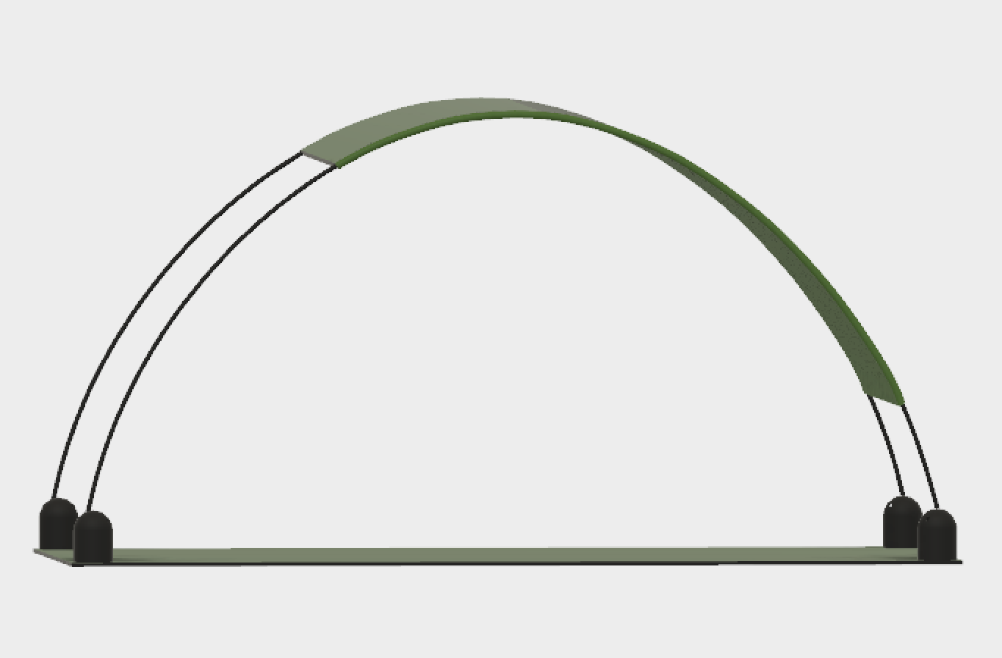
Cable Reels
M
R
M
R
Cable Reels
1-50 | $17.00
50+ | $15.00
Availability | Now
Lead Time | 3-5 Days
"AMETEK Hunter Spring - Custom or Stock, Flat Coiled Springs and Spring Reels."

Slide 9
Cable Reels
T_{cable}
T_{cable}
mgcos45°
F_{motor}
1.12 m
mgsin45°
Θ=45°
F_{motor}
T_{cable}=0.617 kg * 9.8 m/s² * cos⁡(45°)= 2.22 N
2
*When cable reel is in use F_{motor} = 0

Slide 10
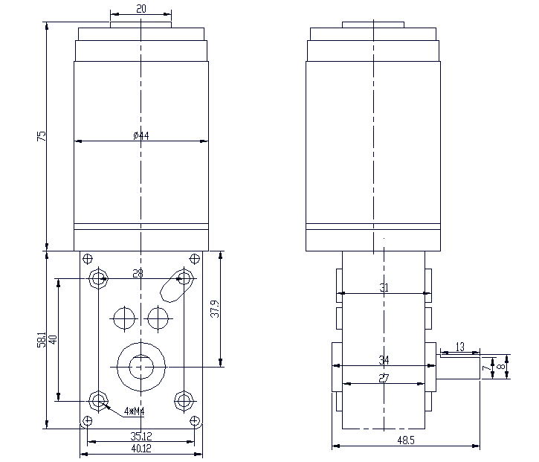
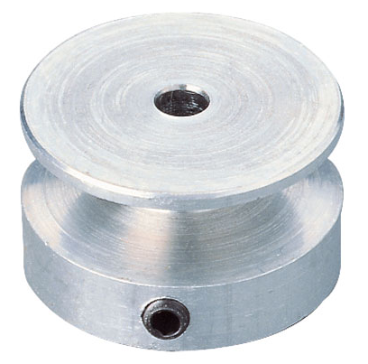
Motor pulley system
http://www.tsinymotor.com/Products/Worm%20Gear%20Motors/2014/0513/26.html
http://static.rapidonline.com/catalogueimages/Product/S50-8987P01WL.jpg

Slide 11
Motor Pulley System
Tsiny Worm Gear Motor
1+ | $20.00
Availability | Now
Lead Time | 3 weeks
V-Belt Pulley Hub
1+ | $6.43
Availability | Now
Lead Time | 2 weeks
F_{motor}
T_{cable}
mgcos45°
F_{motor}
1.12 m
mgsin45°
Θ=45°
2.24 m
T_{cable}
F_{motor}=2.22 N+0.617 kg * 9.8 m/s² * cos⁡(45°)=3.25 N
2
Weight of top shade: 0.617 kg
Cable Tension: 2.22 N*

Slide 12
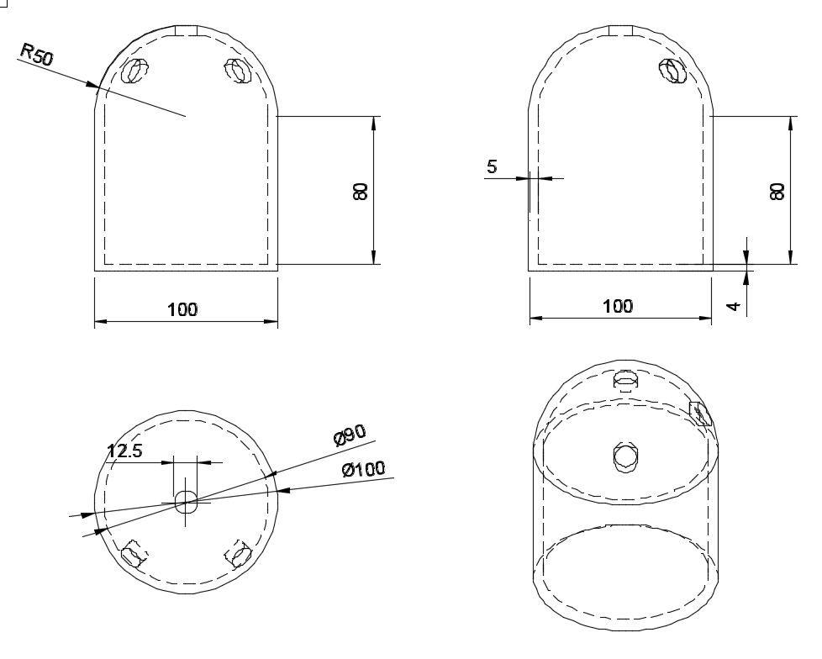
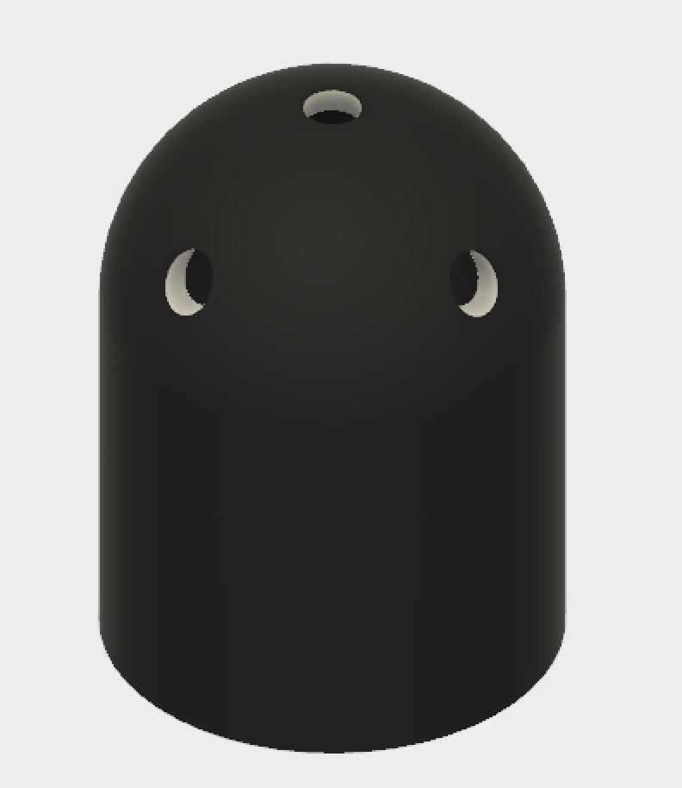
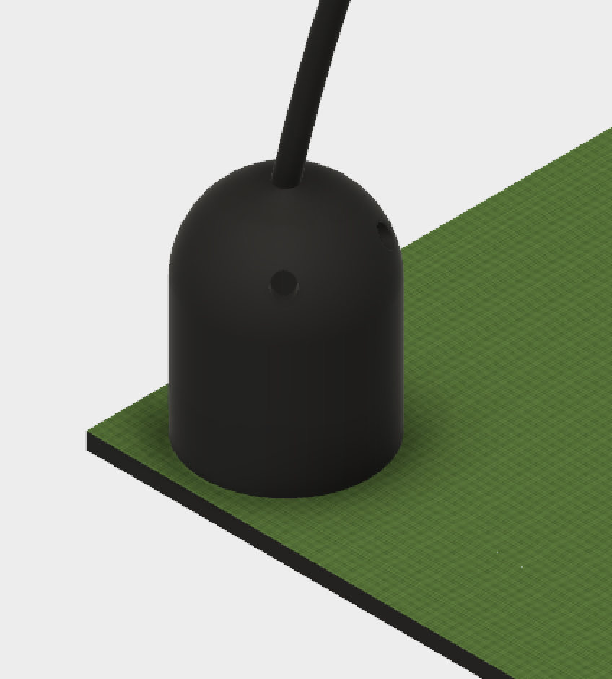
Motor Pulley Base Cover
Notes:
All dimensions in mm

Slide 13
Motor pulley base cover
Custom made piece
3 hole options for latitude considerations
Must be UV resistant, lightweight, inexpensive
Polycarbonate- UV resistant, strong, expensive
Acrylanitrile-Butabiene-Styrene- inexpensive, not UV resistant
Polycarbonate Acrylanitrile-Butabiene-Styrene (PC-ABS)
Material cost estimator: $5.65 per part
Notes:
Cost is for materials based on dimensions and shape of the part

Slide 14
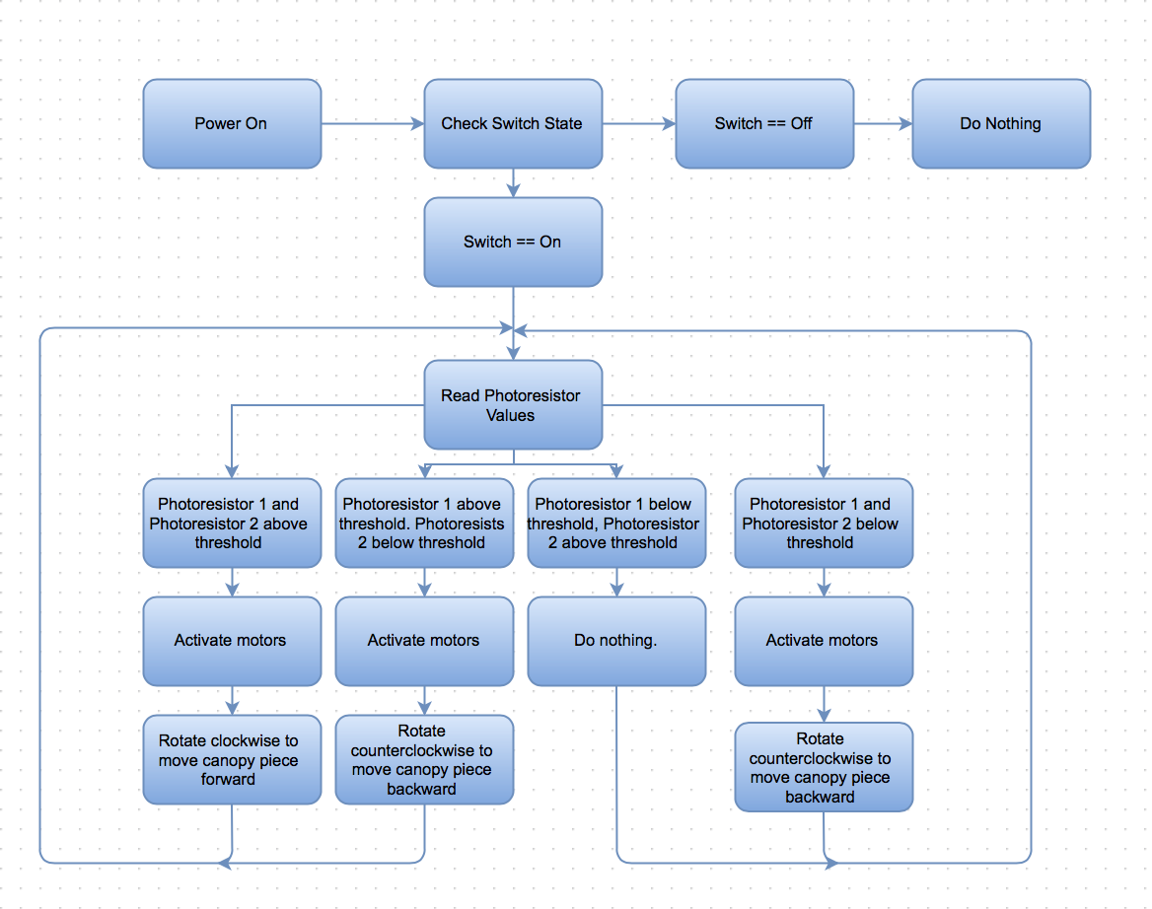
Software

Slide 15
Software
1
2
1
2
Motor moves shade forward until 1 is dark
Motors do not activate
1
2
1
2
Motor moves shade back until 1 is dark and 2 is light
Motor moves shade back until 2 is light

Slide 16
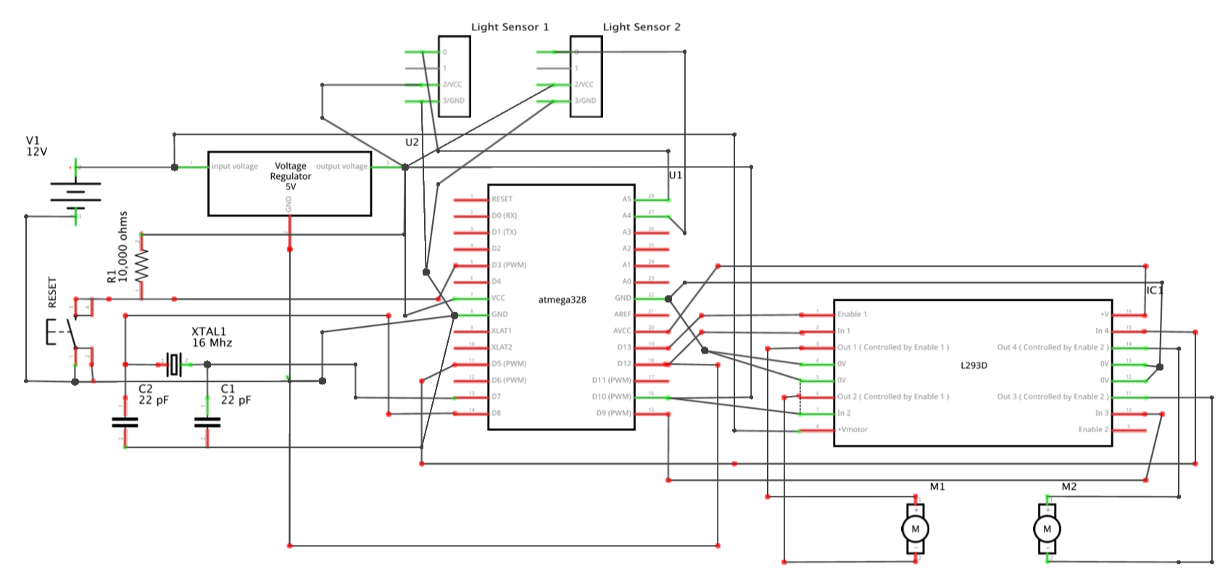
Circuit diagram
Notes:
H bridge used to allow motors to have bi directional capabilities
In prototype arduino was used but for actual device an ATMEGA328 micro controller (atmel)

Slide 17
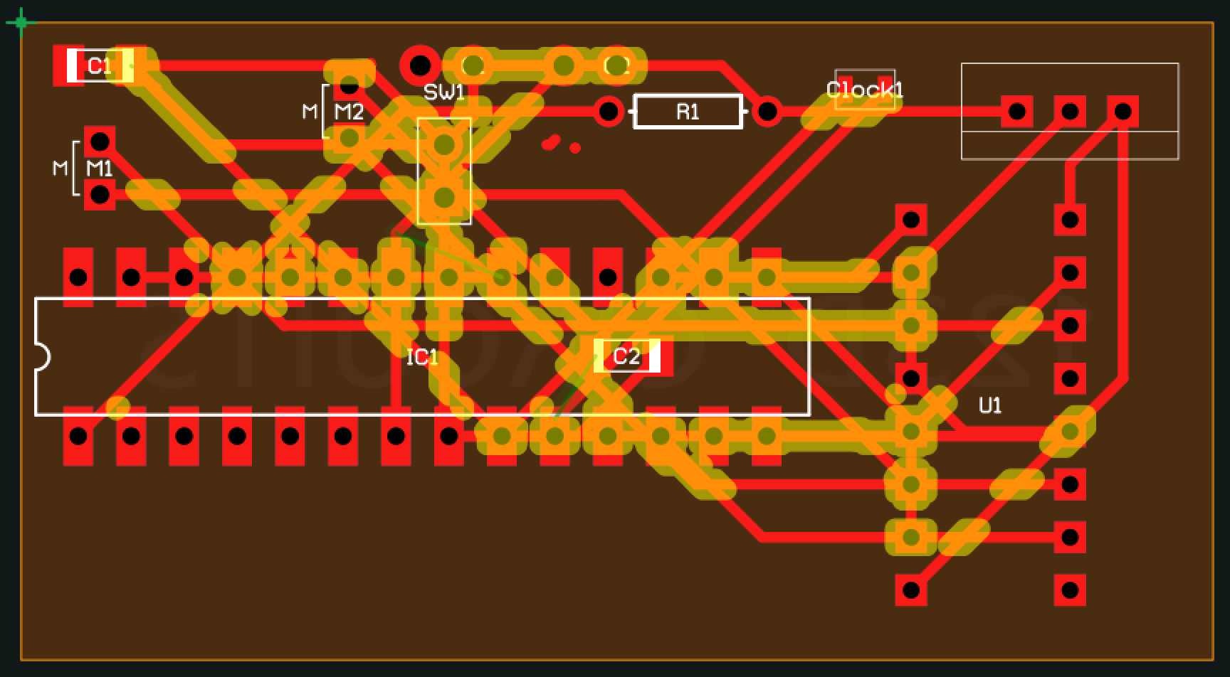
Printed circuit board
Printed Circuit Board
1 | $23.11
2 | $19.32
5 | $16.10
10 | $12.89
Availability | Now
Lead Time | 3 weeks
“PCB Creator” using Fritzing to create and estimate design and cost
Notes:
Arduino used in prototype in combo with DC motors and photoresistors- but for manufacturing the electronic components must be configured into a printed circuit board
Display of the two-layer board that allows for components of the circuit to be soldered to the leads for manufacturing²²

Slide 18
Waterproof Casing
Entire Device must be weatherproof
  Polycarbonate electronics enclosures
  Sized based on contents
Electronics Enclosure
Battery Enclosure
Water/weatherproof
Must be clear
PCB is at least 30.25 cm²
Chosen enclosure is
114.30 x 114.30 x 61.98 mm
Water/weatherproof
Battery is 151 x 102 x 94 mm
Chosen enclosure is
167.39 x 116.59 x 108.46 mm
Battery Enclosure
1-9 | 37.40 USD
10-49 | 35.53 USD
50-99 | 33.76 USD
100-249 | 32.40 USD
Availability | Now
Lead Time | 1-2 weeks
Electronics Enclosure
1-9 | 18.00 USD
10-49 | 15.56 USD
50-100 | 13.52 USD
100-500 | 11.94 USD
500-1000 | 10.90 USD
Availability | Now
Lead Time | 1-2 weeks
Notes:
Because it is specifically for electronics it has the capabilities to connect all the necessary wiring inside the enclosure

Slide 19
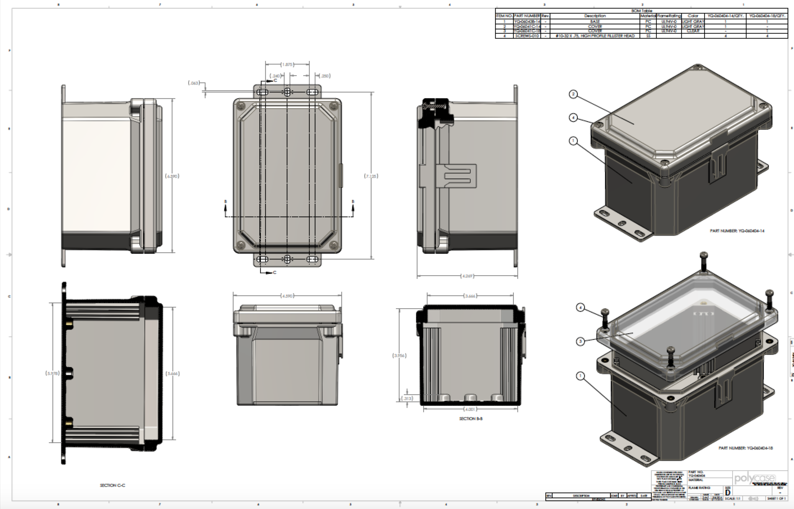
Electronics Enclosure

Slide 20
Bill of materials
Item | Quantity | Price/Unit | Total Cost | Lead Time | Supplier | Supplier Part Number | Weight/Unit | Total Weight
Worm Gear Motor | 2 | 20.00 USD | 40.00 USD | 3 weeks | Tsiny | TS-40GZ868505 | 0.391 kg | 0.782 kg
V-Belt Pulley | 2 | 6.43 USD | 12.86 USD | 2 weeks | Rapid Electronics | MODELCRAFT-50-8987 | N/A | N/A
Cable Reel | 2 | 15.00 USD | 30.00 USD | 3-5 days | Ametek | ML-4575-13 | N/A | N/A
Fiberglass Pole | 2 | 4.80 USD | 9.60 USD | 3-4 weeks | Uni Composite | N/A | 0.2595 kg | 0.518 kg
Light Sensor | 2 | 4.76 USD | 9.52 USD | 1-7 days | Adrafruit | TSL2561 | N/A | N/A
Rechargeable Battery | 1 | 23.75 USD | 23.75 USD | 1-2 days | Power Sonic | PS-12100 | 3.69 kg | 3.69 kg
Solar Panel | 1 | 29.86 USD | 29.86 USD | 3-5 days | Universal Power Group | UPG87511 | 0.365 kg | 0.365 kg
Base | 4 | 5.65 USD | 22.60 USD | 3 weeks | N/A | N/A | 0.20 kg | 0.80 kg
Fabric | 1 | 6.75 USD/yard | 33.75 USD | 1 week | Sun-Dura | N/A | 0.540 kg | 0.540 kg
Waterproof Casing | 1 | 10.37 USD | 10.37 USD | 1-2 weeks | Polycase | ML-441508 | 0.27 kg | 0.27 kg
Shock Cording | 1 | 5.35 USD/5ft | 5.35 USD | 1 week | Paracord Planet | B00HAMHU9A | N/A | N/A
Para Cording | 1 | 5.49 USD/5ft | 5.49USD | 1 week | Paracord Planet | B00KXELTQ2 | N/A | NA
Printed Circuit Board | 1 | 12.89 USD | 12.89 USD | 14+ days | Fritzing | N/A | N/A | N/A
H-Bridge | 1 | 1.58 USD | 1.58 USD | 1 week | Texas Instruments | L239 | N/A | N/A
Microcontroller | 1 | 1.63 USD | 1.63 USD | 1 week | Atmel | ATMEGA 328 | N/A | N/A
Voltage Regulator | 1 | 0.59 USD | 0.59 USD | 1 week | Texas Instruments | LM7805 | N/A | N/A
22 pf Capacitors | 2 | 0.25 USD | 0.50 USD | 1 week | SparkFun Electronics | COM-0857 | N/A | N/A
10 kOhm Resistor | 1 | 0.25 USD | 0.25 USD | 1 week | SparkFun Electronics | COM-08374 | N/A | N/A
16 MHz Clock | 1 | 0.95 USD | 0.95 USD | 1 week | SparkFun Electronics | COM-00536 | N/A | N/A
Notes:
Red are parts chosen through pugh analysis from the progress report- specific choices based on price and convenience
Yellow standard cording-???
Blue circuit components

Slide 21
Conclusions

Slide 22

Ethical and safety concerns
No significant safety concerns for users
  All electronics set up and enclosed
  Wiring enclosed in fabric seams

Slide 23
ethical Considerations and Intellectual Property
No ethical considerations
IP in custom designed components and whole device
Most components are patented parts
Combination of all parts form a novel solution of UV protection
Notes:
Device should be relaxing and enjoyable

Slide 24
Specification Fulfillment
Most were met
Others set in the coding
Weight is slightly over max carried weight
  Still significantly under max wheeled weight
Cost went $51.54 above our set minimum
Further exploration could solve these problems

Slide 25
Reflection
TAKEAWAYS
FUTURE DIRECTION
Parts are expensive!
  And heavy
Timeframe limited success of prototype and planning
Learned to depend on group and work around busy schedules
Decrease price and weight of device and components
Will depend on time commitments and schedules next semester

Slide 26
Acknowledgements
Team members Shilpi and Kelsey
Dr. Frank Yin for the opportunity to solve his proposed problem
Professor Silva and TA Joseph Humphreys for support throughout the process
Thank You!

Slide 27
Questions?

