Slide 1
Preliminary Oral Report: Auto Shade Device
Kelsey Lipman
Group 26: Kelsey Lipman, Shilpi Ganguly, Molly Shay
Client: Dr. Frank Yin

Slide 2
General Outline
Background
Existing Solutions/ Patent Research
Need and Project Scope
Design Specifications
Design Schedule
Organization of Team Responsibilities

Slide 3
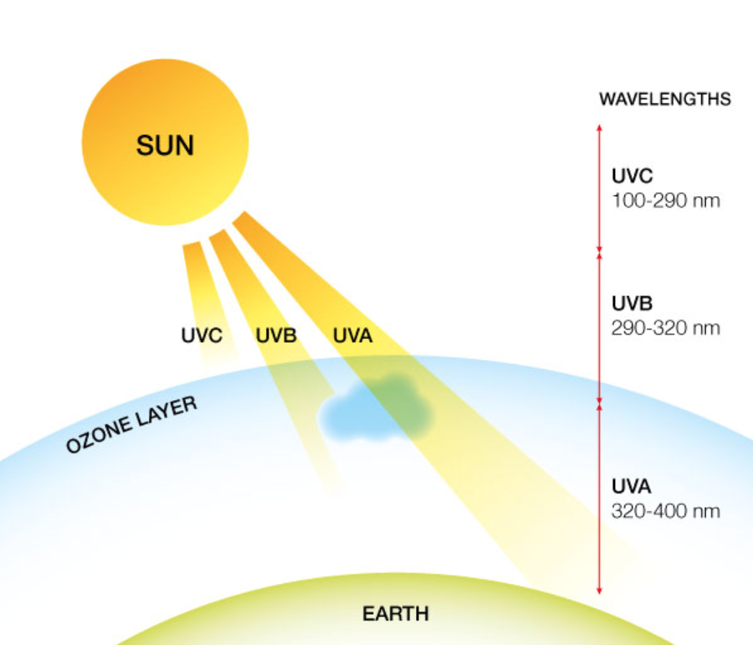
Background: UV Exposure
Notes:
Three major sections of UV radiation ranging from 100 nm to 400 nm. Include UVA, UVB, and UVC. Luckily for us, the outer layer of the Earth’s atmosphere prevents the short wavelength, high energy UVC rays from reaching the Earth’s surface. However, the UVA and UVB rays can penetrate the atmosphere and reach the Earth’s surface. UVA and UVB can therefore have mutagenic affects on the DNA structure of the human body

Slide 4
Effects on the Human Body
Skin
Mutagenic effect on tumor suppressor gene p53
$500 million per year to treatment of skin cancer in US
Eyes
Photokeratitis: “sunburn of the cornea”
Cataracts related to geographic latitude and sunlight hours
Immune System
Protection can reduce future risk of skin cancer
Short-term and long-term damage
Evidence of UV-induced immunosuppression: the mouse study
Interferes with activation of T-cells: depletion of Langerhans cells
Promotes tumorigenesis and progression
Notes:
The UVA and UVB rays that reach the human body on the Earth’s surface has three major implications on your body: the skin, the eyes, and the immune system. p53, a common tumor suppressor gene, is shown to be an early target of UV radiation. Mutation of this gene promotes tumorigenesis and progression. Not only is exposure to the skin dangerous, it is extremely expensive. Approximately $500 million dollars per year are spent on skin cancer treatment in the US. Fortunately, protection can reduce future risk of skin cancer, shown by studies with basal cell carcinomas. Individuals with a history of basal cell carcinoma who protected themselves from sun exposure had fewer following basal cell carcinomas.
The eye is at risk for temporary and permanent damage. Photokeratitis is referred to as sunburn of the cornea. It is typically not noticeable until hours after exposure. Symptoms include excruciating pain, tears, and involuntary closing of the eyelids. Thankfully, the cornea has the ability to reestablish itself, and symptoms typically subside within two hours. A cataract is referred to as a clouding of the lens leading to reduced vision. Studies have shown that geographic latitude and sunlight hours are positively correlated with cataract incidence across the globe.
There is evidence that UV exposure causes suppression of the immune system. One particularly study helped support the ideas behind it. Skin tumors in mice produced by chronic UV exposure were rejected when transplanted, revealing that the skin tumors are highly immunogenic. Recipient mice were then given immuno-suppressive drugs, and the tumors were not rejected. Other recipient mice were treated with exposure to UVB radiation, and rejection was also prevented. UV exposure depletes the number of Langerhans cells, the primary antigen presenting cells in the skill. Reduction in immuno-suppression promotes tumor formation and progression.

Slide 5
Most Common Skin Cancers
Squamous Cell Carcinoma
Basal Cell Carcinoma

Slide 6
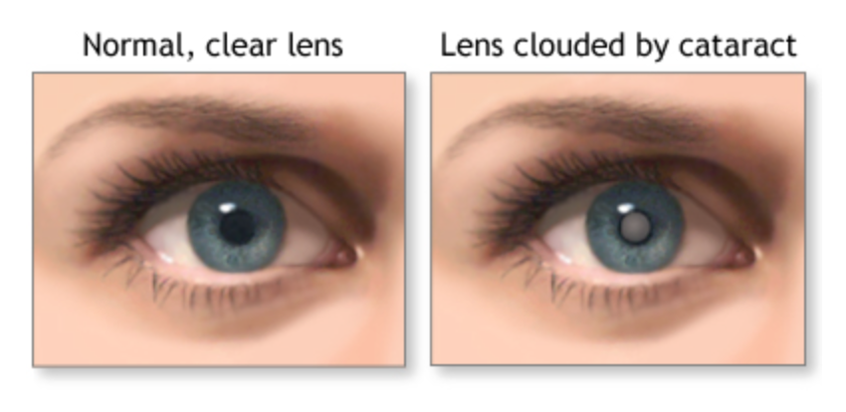
Cataracts

Slide 7
Exploration of Existing Solutions and Patents

Slide 8
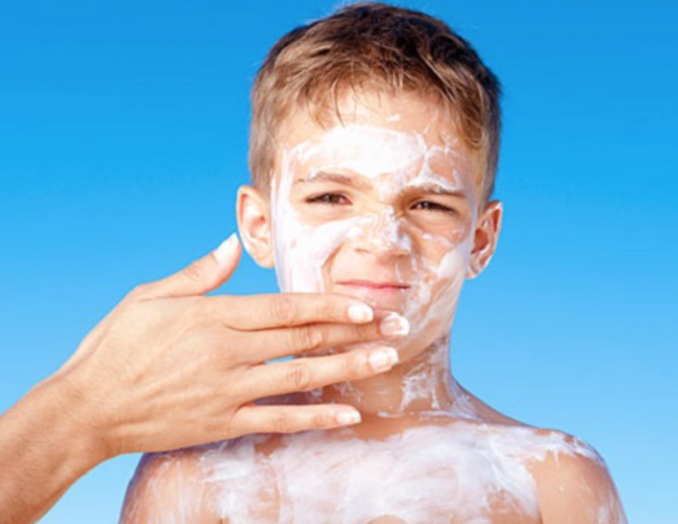
Sunscreen
Advantages
SPF>15 filters 93% of UVB rays
Disadvantages
Need to reapply consistently
Unequal coverage
Lose protection efficiency in water
Sticky and inconvenient
Chemical toxicity of ingredients

Slide 9
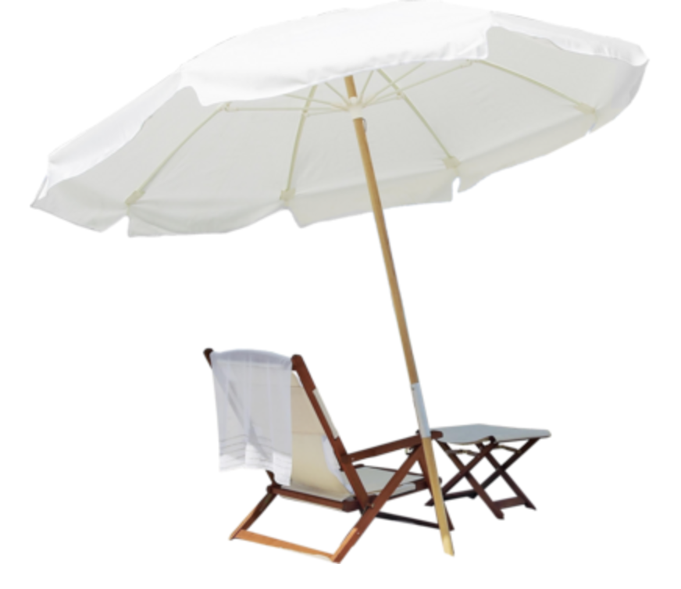
Umbrellas
Advantages
Portable
Protection from rain and sun
Disadvantages
Semi-fixed once set up
Multiple adjustments throughout day
UV present beneath umbrella

Slide 10
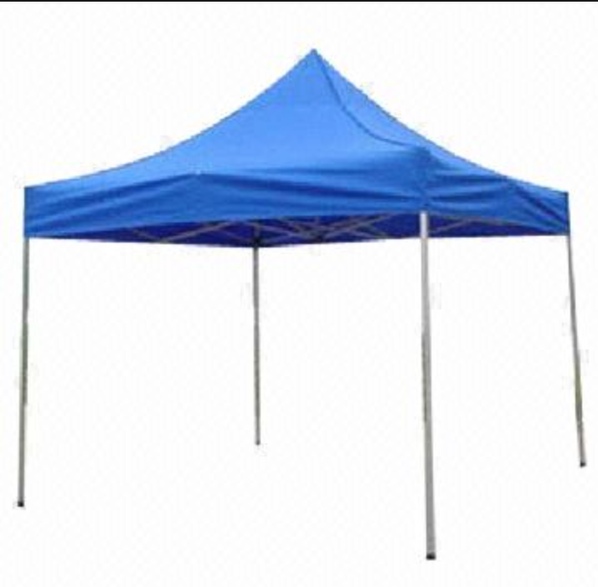
Canopies
Advantages
Large area of shape
Fabrics with high UPF ratings
Disadvantages
Fixed
Requires multiple people for setup
Expensive
Heavy

Slide 11
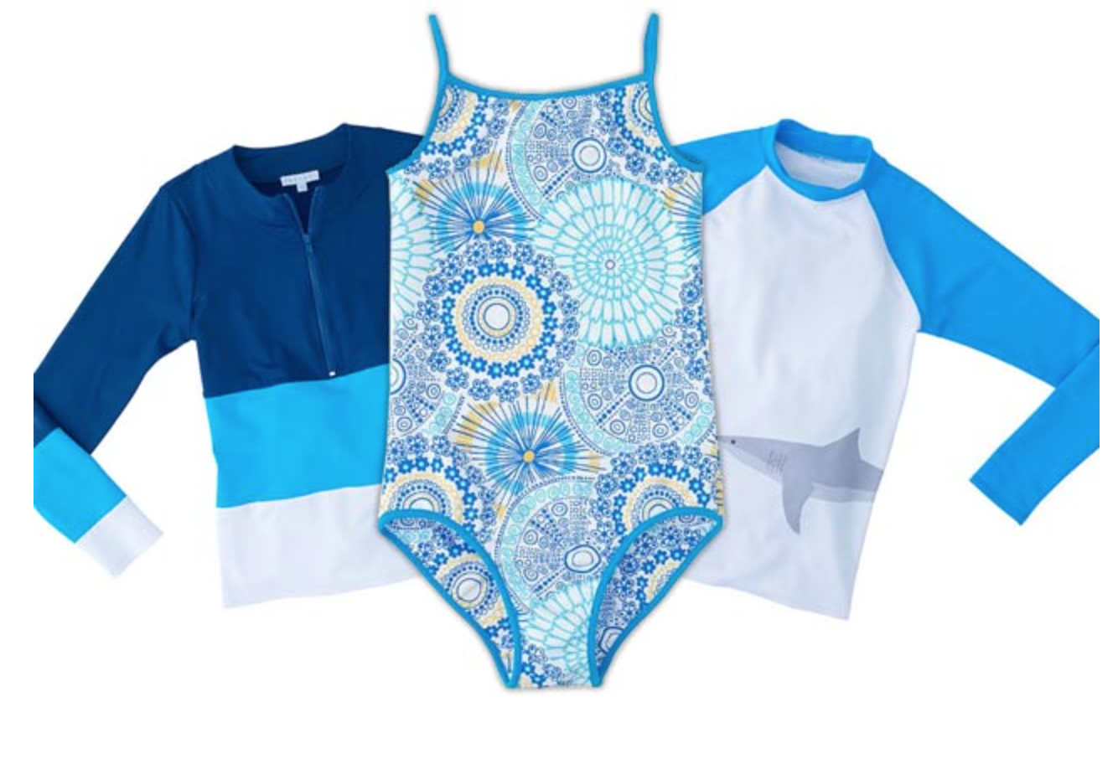
Sun-Protective Clothing
Clothes made with fabrics with high Ultraviolet Protection Factor (UPF) by using tight weave, dark color, water repellant, and/or chemical treatment
Advantages
No need to reapply
Not Messy
Moves with the user
Disadvantages
Expensive
Clingy/Uncomfortable
Potential use of harmful chemicals
Area unexposed (hands, face, etc.)

Slide 12
UPF Rating
UPF Range | Category of Protection | Effective UV-R Transmission (%)
15-24 | Good | 6.7-4.2
25-39 | Very Good | 4.1-2.6
40-50, 50+ | Excellent | Less than 2.5
Notes:
Need a minimum of 30 to obtain Skin Cancer Foundation’s Seal of Recommendation.
GO through each of the effective UV-R percentages

Slide 13
Patent: Automated Sun-Tracking Umbrella
Patent WO2013020562 A1 : designed to automatically track sun during the day using optical sensors that pinpoint position of sun
Powered by rechargeable battery/solar panel
Advantages
Automatic adjustment to provide maximum protection
Disadvantages
No user preference available
Notes:
Make a note how not all UV exposure is bad. No exposure to UV can cause a vitamin D deficiency

Slide 14
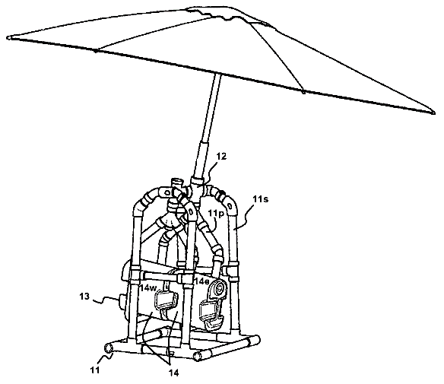
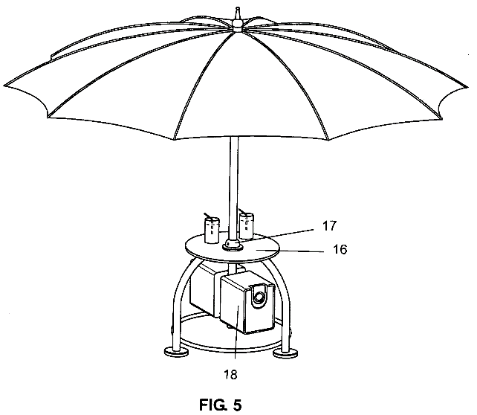
Patent: Automated Movement of Umbrella
Manual and automatic movement of umbrella
Advantages
User preference available
Disadvantages
Add-on piece to umbrella
less portability
Requires users to be alert to readjust

Slide 15
Need/Project Scope
Low-cost, portable, shade device that automatically adjusts according to user preference to provide UV protection
High cost of current devices
Messy and toxic sunscreen
Requirement to manually adjust current techniques
Lack of accommodating features
Insufficient materials for UV protection
Lack of full coverage

Slide 16
Design Specifications
Attributes | Units | Specific Values | Notes
Temperature Range | Degrees C | -40 to 58
Cost
Low Cost | USD | < 200
Protection
UV Protective Material | UPF | > 30
Water Resistant |  |  | rain/splash resistant
Light Weight
If Carried | lbs | < 10
If Wheeled | lbs | < 30
Easy to Use
Set up time | minutes | < 5
Extended periods of use | hours | > 8
Use on multiple types of terrain |  |  | be able to stand on grass, sand, and impenetrable surfaces
Wind Resistant | mph | > 40
Minimum Lifetime | years | 5
Shadow to fit 2 adults | ft | > 4 x 6
Minimum Height | meters | 1.12
Movement
Adjusting time | seconds | < 60
Sensors check shade periodically | minutes | 60
Solar powered
Notes:
Go through each of these briefly

Slide 17
Design Calculations
Low-Cost: (Less than 200 USD)
Comparison to Sun Protective Clothing:
𝐴𝑣𝑔 𝑐𝑜𝑠𝑡 𝑜𝑓 𝑠𝑢𝑛 𝑝𝑟𝑜𝑡𝑒𝑐𝑡𝑖𝑣𝑒 𝑇 − 𝑠h𝑖𝑟𝑡 = 50 𝑈𝑆𝐷 𝐶𝑜𝑠𝑡 𝑓𝑜𝑟 2 𝑝𝑒𝑜𝑝𝑙𝑒 = 2 ∗ 50 𝑈𝑆𝐷 = 100 𝑈𝑆𝐷 𝐴𝑠𝑠𝑢𝑚𝑖𝑛𝑔 𝑒𝑎𝑐h 𝑝𝑒𝑟𝑠𝑜𝑛 𝑏𝑢𝑦𝑠 𝑜𝑛𝑒 𝑠h𝑖𝑟𝑡 𝑝𝑒𝑟 𝑦𝑒𝑎𝑟, 𝐶𝑜𝑠𝑡 𝑜𝑓 𝑐𝑙𝑜𝑡h𝑖𝑛𝑔 = 500 𝑈𝑆𝐷 𝑝𝑒𝑟 5 𝑦𝑒𝑎𝑟𝑠
𝐶𝑜𝑚𝑝𝑎𝑟𝑖𝑠𝑜𝑛 𝑡𝑜 𝑑𝑒𝑣𝑖𝑐𝑒: 500 − 200 = 300 𝑈𝑆𝐷 𝑆𝑎𝑣𝑒𝑑 𝑜𝑣𝑒𝑟 5 𝑦𝑒𝑎𝑟 𝑠𝑝𝑎𝑛
Comparison to Ideal Sunscreen Use:
𝐴𝑣𝑔 𝑐𝑜𝑠𝑡 𝑝𝑒𝑟 𝑦𝑒𝑎𝑟 𝑓𝑜𝑟 𝑎𝑑𝑢𝑙𝑡 𝑢𝑠𝑖𝑛𝑔 𝑖𝑑𝑒𝑎𝑙 𝑎𝑚𝑜𝑢𝑛𝑡 𝑜𝑓 𝑏𝑎𝑠𝑖𝑐 𝑠𝑢𝑛𝑠𝑐𝑟𝑒𝑒𝑛 𝑏𝑟𝑎𝑛𝑑 = 235.96 𝑈𝑆𝐷
𝐶𝑜𝑠𝑡 𝑓𝑜𝑟 2 𝑝𝑒𝑜𝑝𝑙𝑒 𝑝𝑒𝑟 𝑦𝑒𝑎𝑟 = 2 ∗ 235.96 = 471.92 𝑈𝑆𝐷 𝐶𝑜𝑠𝑡 𝑓𝑜𝑟 5 𝑦𝑒𝑎𝑟𝑠 𝑜𝑓 𝑠𝑢𝑛𝑠𝑐𝑟𝑒𝑒𝑛 𝑢𝑠𝑒 𝑓𝑜𝑟 2 𝑝𝑒𝑜𝑝𝑙𝑒 = 5 ∗ 471.92 = 2,359.60 𝑈𝑆𝐷 2,359.60 − 200 = 2,159.60 𝑈𝑆𝐷 𝑆𝑎𝑣𝑒𝑑 𝑜𝑣𝑒𝑟 5 𝑦𝑒𝑎𝑟 𝑠𝑝𝑎𝑛
Notes:
So how did we come up with 200 dollars? Low cost relative to what? We compared prices to current solutions.

Slide 18
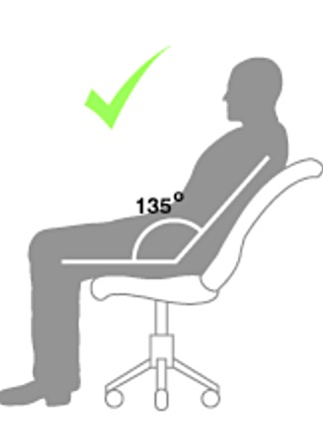
Design Calculations
Minimum Height: (1.12 meters)
0.42 m
0.60 m
0.60 m
45º
0.53 m
0.53 m
Notes:
How did we determine the minimum height of the device? Using average, adult male anatomical values shown, we assumed the adult would be reclined at a 45 degree angle in a chair.

Slide 19
Design Calculations
Maximum Weight If Carried: (< 10 Pounds)
Average elbow flexion of older woman=160 N
According to Newton's Second Law F=ma
160 N=mass(9.81m/s²)
mass=16.3099 kg =35.9 lbs
(10 lbs/35.9 lbs) x 100=27.8% of maximum exertion of flexion

Slide 20
Design Schedule
 | 8/24 | 8/31 | 9/7 | 9/14 | 9/21 | 9/28 | 10/5 | 10/12 | 10/19
Project Selection |  | 9/02
Project Scope |  |  | 9/9
Background Research/Need
Development of Design Specifications
Research on Existing Solutions
Preliminary Written Report |  |  |  |  | 9/25
Preliminary Oral Report |  |  |  |  |  | 9/28
Webpage Functional |  |  |  |  |  |  | 10/6
Design Safe |  |  |  |  |  |  | 10/8
Concept Generation
Pugh Chart Analysis
Past Work
Past Deadline
Future Work
Future Deadline
Ongoing Work

Slide 21
Design Schedule
 | 9/28 | 10/5 | 10/12 | 10/19 | 10/26 | 11/2 | 11/09 | 11/16 | 11/23 | 11/30 | 12/7
Concept Analysis and Selection
Decision Matrix/Concept Screening
Progress Written Report |  |  |  | 10/23
Progress Oral Report |  |  |  |  | 10/26
Concept Embodiment
Design Optimization Research
Final Written Report |  |  |  |  |  |  |  |  |  | 12/04
Final Oral Report |  |  |  |  |  |  |  |  |  |  | 12/07
Webpage Maintenance
Weekly Updates
Communicate with Client
Past Work
Past Deadline
Future Work
Future Deadline
Ongoing Work

Slide 22
Current Organization of Team Responsibilities
All members will participate in concept generation and building of the prototype
Kelsey
First Oral Presentation
Material Analysis
Shilpi
Second Oral Presentation
Molly
Third Oral Presentation
Website Updates
Safety Analysis
Ordering Neccessary Materials
Mechanical Design
Assessing Feasibility of Project Ideas

Slide 23
Acknowledgements
Team Members: Shilpi Ganguly, Molly Shay
Mentor: Dr. Frank Yin
Professor: Dr. Jonathan Silva
TA: Joseph Humphries

Slide 24
Questions?

