Slide 1
Auto-Shading Device
Group 26: Shilpi Ganguly, Molly Shay & Kelsey Lipman
Client: Dr. Frank Yin

Slide 2
Overview of Need and Scope
Low-cost, portable, shade device that automatically adjusts according to user preference to provide UV protection
High cost of current devices
Messy and toxic sunscreen
Requirement to manually adjust current techniques
Lack of accommodating features
Insufficient materials for UV protection
Lack of full coverage
Notes:
Skin cancer is currently the number one form of cancer in the United States. As UV radiation is the number one cause of skin cancer there exists a need to look into current UV protection methods. Currently those devices which boast high UV protection levels usually boast extremely high costs as well soaring well into the hundreds of dollars and tend to be large and difficult to adjust and maneuver for the user. Those devices that are lower cost are made of insufficient materials for UV protection and often lack the size required to provide the full coverage necessary. Furthermore, sunscreens commonly used for UV protection have recently been found to have toxic health implications.
Therefore there exists a need to create a low-cost, portable shading device which automatically adjusts according to user preference to provide UV protection.

Slide 3
Design Requirements
Attributes | Units | Specific Values | Notes
Temperature Range | Degrees C | -40 to 58
Cost
Low Cost | USD | < 200
Protection
UV Protective Material | UPF | > 30
Water Resistant |  | < 3% moisture regain
Light Weight
If Carried | kg | < 4.5
If Wheeled | kg | < 13.6
Easy to Use
Set up time | minutes | < 5
Extended periods of use | hours | > 8
Use on multiple types of terrain |  |  | be able to stand on grass, sand, and impenetrable surfaces
Wind Resistant | km/hr | > 64
Minimum Lifetime | years | 5
Shadow to fit 2 adults | meters | > 1.2 x 1.8
Minimum Height | meters | 1.12
Movement
Adjusting time | seconds | < 60
Sensors check shade periodically | minutes | 60
Solar powered
Notes:
To create such a device the following design requirements were set forth.
Based on maximal temperature ranges recorded across the world along with the functional ranges of commonly used arduino sensors, we selected a temperature range of -40*C to 58*C as the functional range.
After conducting a cost analysis of sun-protective clothing costs per year and researching the prices of a variety of devices which boast to provide maximal UV protection, the cost of $200 was selected as the maximal price.
Materials with UPF of 30 or higher earn The Skin Cancer Foundation’s Seal of Recommendation and is our benchmark for the device UPF rating.
Based upon the moisture regain values of widely used fabrics in sun protective devices a value of <3% was selected to ensure the device covering remains useful in the presence of water.
Maximal weight values were selected after conducting elbow flexion calculations for an elderly women, assumed to be the weakest of our clientele.
5 minute set-up time was selected as reasonable based upon the set-up time of similar devices such as umbrellas or tents.
8 hours of minimal usage time was selected based upon the average amount of daylight in the US (~10 hours).
Multiple terrain types ensures the user is able to use the device in a variety of situations increasing the usability of the device.
Wind values were selected based upon common resistance values for similar sun protection devices.
Portable power required so that the device can be utilized outdoors.
An hour between adjustments was selected due to the relative minimal movement of the sun per hour (~18deg).
A 5 year minimum lifetime was chosen based upon current sun protection device lifetimes.
2 adults was chosen as the baseline shade protection as more often than not more than one person go on outings together.
A minimum device height of 1.12m was chosen based upon height calculations of an average human in a reclined chair.

Slide 4
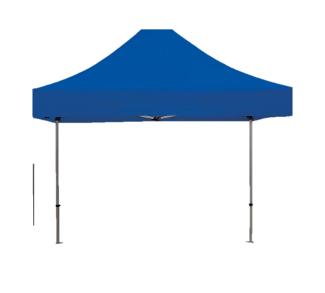
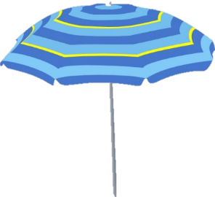
4 Major Design Components
1. Adequately Blocks Sun Rays
2. Able to detect sunlight
3. Hold Portable Charge
4. Functional Mechanical Design

Slide 5
Analysis for Design Component 1
Blockage of UV rays

Slide 6
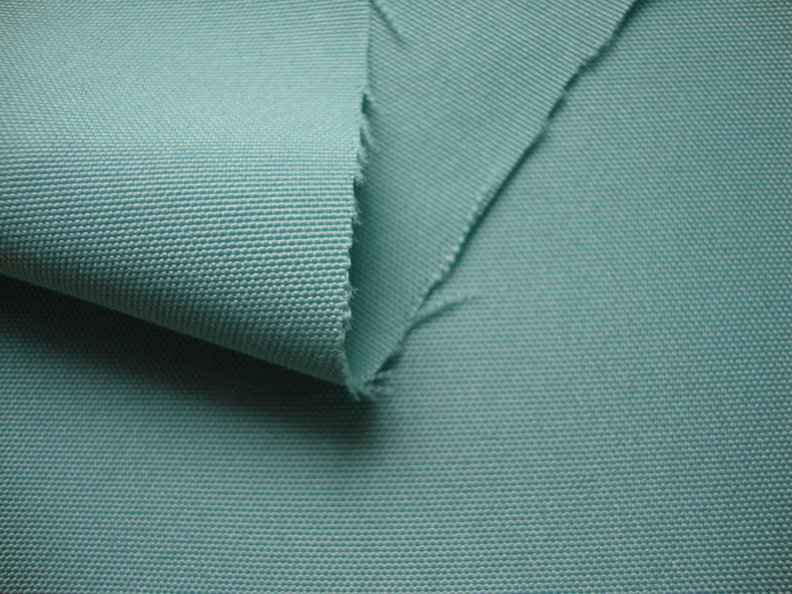
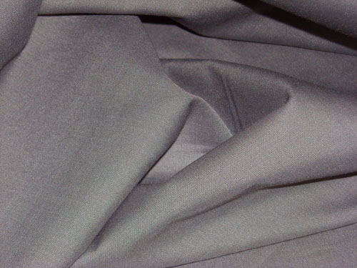
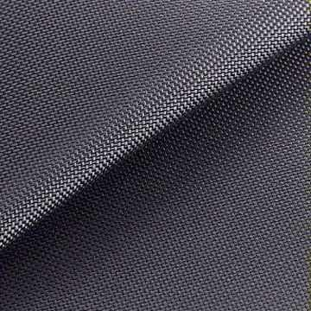
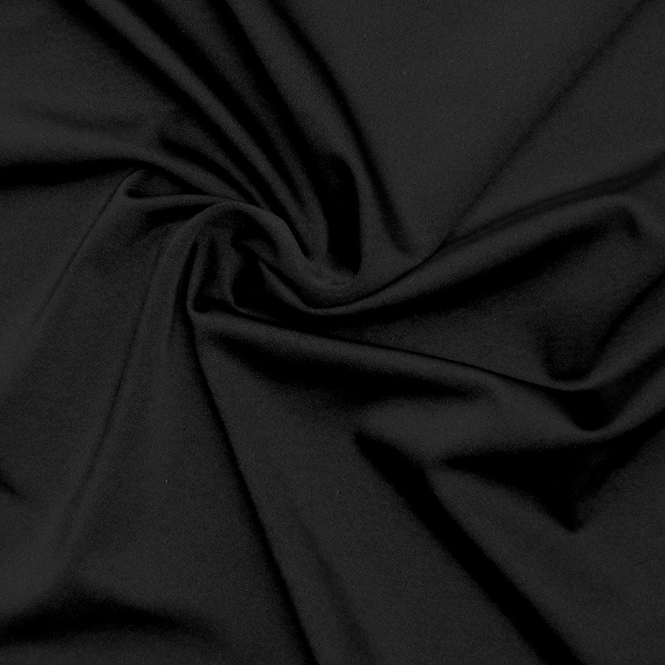
Fabric Covering
Specification | Ideal
Weight (denier) | Low Denier (For Portability)
Cost ($/kg) | Low Cost
UPF Protection Level | High UPF Protection
Weave Density (g/cm³) | High Weave Density
Tension (g/denier) | Low Tension
Moisture Regain (%) | Low Moisture Regain
Thermal Conductivity (W/mK) | Low Thermal Conductivity
Effect of Sunlight | Little to no effects due to exposure
Effects of Mildew | Moderate to High Resistance to Mildew
Polyester
Cotton
Cotton/Polyester 50/50 Blend
Nylon
Spandex
Notes:
**amount of water a completely dry fiber will absorb from the air at a standard condition of 70 degrees F and a relative humidity of 65%

Slide 7
Lowest Moisture Regain
Lowest Weight
Cotton
Spandex
Polyester
Spandex
Lowest Cost
Lowest Thermal Conductivity
Cotton
Polyester
Highest UPF Protection Level
Spandex
Polyester
Spandex
Nylon
Smallest Effects from Sunlight
Highest Weave Density
Polyester
Spandex
Cotton
Polyester
Smallest Effects from Mildew
Highest Tension
Polyester
Spandex
Nylon
Polyester
Notes:
Lowest Weight – 0.7-2.3 Denier ; 10-70 Denier
Lowest Cost - $0.31, $0.37
Highest UPF – 90.4% >50+ ; 61% > 50+
Highest Weave Density – 1.5, 1.42 g/cm^3
Highest Tension – 8.8-4.3 g/denier; 2.8-7.0 g/denier
Lowest Moisture Regain – 0.4%, 0.6%
Thermal conductivity- 0.03, 0.05 W/mK
Smallest Sun – Softening or sticking at high temps: Good sun ; generally not affected
Mildew – Absolute resistance, good to excellent

Slide 8
FABRIC TYPE PUGH CHART
 | Weight | Cotton | Nylon | Polyester/Cotton 50/50 Blend | Polyester | Lycra/Elastane (Spandex)
Cost ($/kg) | 6 | 10 | 6 | 8 | 10 | 2
Weight (denier) | 4 | 10 | 2 | 6 | 3 | 10
UPF Protection Level | 10 | 3 | 5 | 2 | 4 | 7
Weave Density (g/cm³) | 6 | 3 | 4 | 10 | 5 | 2
Tension (g/denier) | 3 | 5 | 10 | 7 | 7 | 2
Moisture Regain (%) | 3 | 2 | 3 | 5 | 10 | 10
Thermal Conductivity (W/mK) | 6 | 2 | 2 | 5 | 7 | 10
Effects of Sunlight | 3 | 4 | 4 | 7 | 10 | 10
Effects of Mildew | 3 | 2 | 5 | 7 | 10 | 10
Weighted Score | 440 | 199 | 196 | 260 | 295 | 290
Normalized Score |  | 0.452 | 0.445 | 0.591 | 0.670 | 0.659

Slide 9
Analysis for Design Component 2
DETECTION of SUN FOR ADEQUATE DEVICE ADJUSTMENT

Slide 10
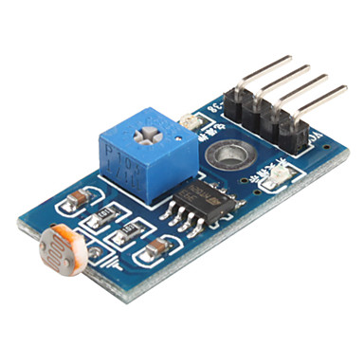
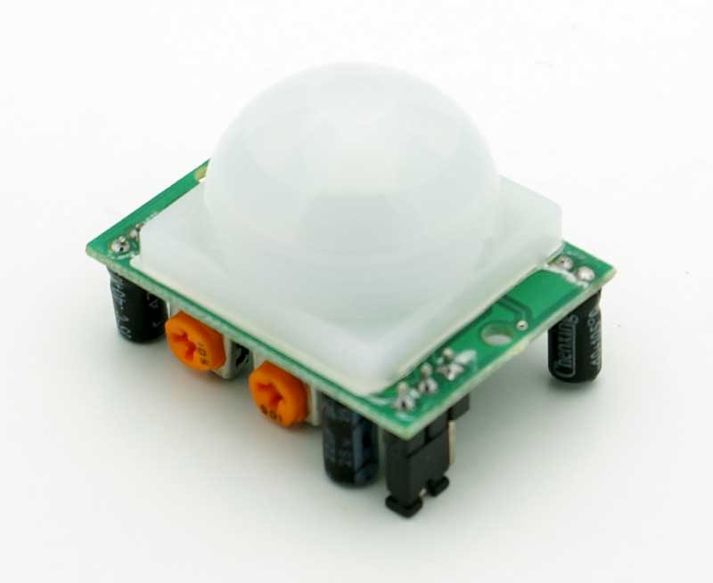
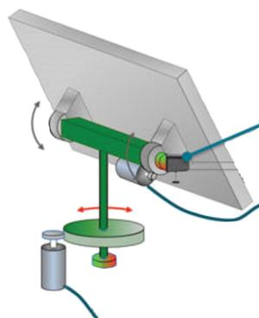
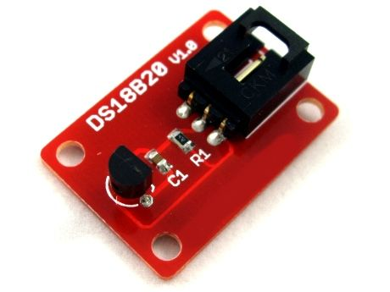
Sensor Type
Specification | Ideal Choice
Cost ($/kg) | Low Cost
Convenience | High Convenience
Sensitivity | High Sensitivity
Reliability | High Reliability
Portability | High Portability
PIR Motion Sensor
Arduino Light Sensor
Arduino Temperature
Automated Sun Tracking System
Notes:
Low cost to ensure the device cost remains below $200
High convenience ensure the sensor is able to be easily manipulated by the user with minimal effort so that the user is able to cover the fraction of their body with the amount of shade they desire.
High sensitivity ensures the sensor is able to detect the changes in the environment and produce the adequate changes to the device
High reliability ensures the sensor is not disrupted by extraneous environmental changes
High portability ensures the sensor keeps the device portable and below weight limits.

Slide 11
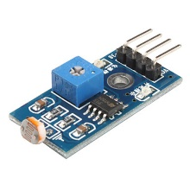
Lowest Cost
Arduino Temperature
Arduino Light Sensor
Highest Portability
Arduino Temperature
Highest Convenience
Arduino Light Sensor
Arduino Temperature
Arduino Light Sensor
Highest Reliability
Arduino Temperature
Arduino Light Sensor
Highest Sensitivity
Arduino Light Sensor
Automated Sun Tracking System
Notes:
The lowest cost sensors were the Arduino light sensor which was found to be $7.00 and the Arduino temperature sensor which was found to be $11.50.
The highest convenience sensor was found to be the light sensor as it can be utilized as both a fixed or non-fixed sensor and the user can place the sensor where he or she desires shade to be and the device will automatically adjust throughout the day to ensure the sensor isn’t detecting light. The temperature sensor would need to be mounted and environmental variations in temperature would render the device non-adjustable and non-usable in a variety of environments.
Highest sensitivity – Light sensor as it can easily detect whether photons are present or not and the sensitivity of light sensors can be adjusted. Automated sun tracking system also is designed to track the sun which would make it highly sensitive but non-usable due size, cost, etc.
Highest portability – All the Arduino sensors were found to range in the weight of 5.67g-29.38g making them all feasible.
Highest Reliability- The light sensor is only controlled by the presence of light making it fairly reliable. Similarly The Temperature sensor is only controlled by the fluctuations of temperature but due to a variety of temperatures in a variety of environments it isn’t a feasible option for this device.

Slide 12
SENSOR TYPE PUGH CHART
 | Weight | Motion Sensor | Temperature Sensor | Sun Tracking System | Light Sensor
Cost ($/kg) | 6 | 4 | 6 | 2 | 10
Ease of User Use | 8 | 5 | 5 | 2 | 10
Sensitivity | 6 | 2 | 2 | 10 | 10
Reliability | 6 | 1 | 1 | 10 | 10
Portability | 5 | 7 | 7 | 2 | 8
Weighted Score | 310 | 117 | 129 | 158 | 300
Normalized |  | 0.377 | 0.416 | 0.510 | 0.968

Slide 13
Sensor Placement
Fixed to Top
S
DEVICE
Specification | Ideal Choice
Wind Resistance | High Wind Resistance
Water Resistant | High Water Resistance
Adequate Exposure | Able to constantly detect
User Preference | Highly customizable
S
Fixed to Side
S
Fixed to Ground
S
GROUND
Unfixed
Notes:
The sensor needs to be able to withstand wind and water present in outdoor environments.
The sensor also needs to be able to adequately detect changes in the environment requiring adequate exposure to the environment.
User preference ensures that the sensor is placed somewhere that the user and easily manipulate it.

Slide 14
Highest Wind Resistance
S
S
S
S
Best Exposure
Unfixed
Fixed to Side
Unfixed
Fixed to Top
S
S
S
Highest Water Resistance
Easiest User Accessibility
Unfixed
Fixed to Side
Unfixed
Notes:
An unfixed sensor on the ground would not be in direct contact with the wind and further measures could be utilized to ensure it isn’t blown away. A sensor fixed to the side would have a lower risk of being blown away.
An unfixed sensor on the ground would technically be constantly covered by the covering ensuring some protection from the rain. A sensor fixed to the side would be slightly away from direct exposure to rain.
An unfixed sensor can be placed directly by the user in the place the user wants to be in shade leading to the best exposure to the environment. A sensor placed on top would also be the most exposed to the environment as well.
Only the unfixed sensor gives the user the ability to adjust the device to the amount of shade the user prefers.

Slide 15
SENSOR PLACEMENT PUGH CHART
 | Weight | Fixed Side Sensor | Fixed Top Sensor | Fixed Ground Sensor | Non-fixed Sensor
Wind Resistance | 5 | 5 | 1 | 3 | 6
Water Resistance | 6 | 5 | 1 | 3 | 6
Adequate Exposure | 10 | 3 | 8 | 2 | 7
User Preference | 10 | 0 | 0 | 0 | 9
Weighted Score |  | 85 | 91 | 53 | 226
Normalized Score |  | 0.27 | 0.29 | 0.17 | 0.73

Slide 16
Analysis for Design Component 3
POWER

Slide 17
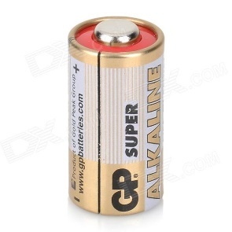
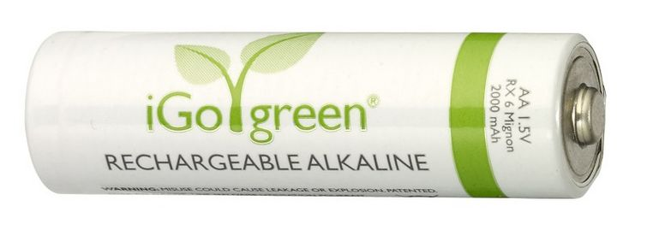
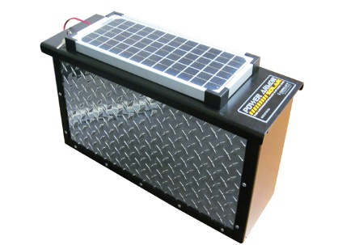
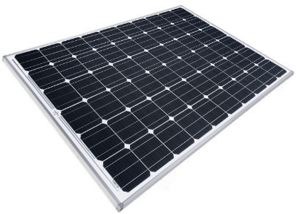
Power Source
Specification | Ideal Choice
Ease of Use/Convenience | Little to no effort for User. Highly Convenient
Charging Speed | Fast Charging Speeds
Cost | Low Cost
Portability | Low Weight Source
Reusability | Can be reused
Alkaline Batteries (rechargeable)
Alkaline Batteries (non-rechargeable)
Solar Power
Solar Power with Rechargeable Battery
AC Power
Notes:
The power source chosen should ensure the user is not inconvenienced as to minimize frustrations.
Charging speed ensures the charge wait time for the device is not inconvenient.
Low cost so as to keep the total device cost down below $200.
Portability ensures the power source isn’t so heavy or wired so that the final product is unable to be carried.
Reusability ensures the device is able to surpass the lifetime minimum of 5 years.
Primary Batteries have a definite lifetime and cannot be re-charged
Secondary batteries can be re-charged by passing electricity through their electrodes
Solar Power converts energy from the sun to usable electricity
AC power contains flowing electric charge that reverse direction periodically.

Slide 18
Highest Convenience
Solar Power with Rechargeable Battery
Solar Power
Highest Portability
Solar Power
Solar Power with Rechargeable Battery
Quickest Charging Speed
AC Power
Solar Power
Highest Reusability
Solar Power with Rechargeable Battery
Solar Power
Lowest Cost
AC Power
Solar Power
Notes:
The highest convenience power sources were found to be the solar power rechargeable batter and the solar power. Once solar panels are installed they require little to no maintenance. An inherent issue with solar panels is its inability to provide electricity when light is not present, which is rectified with a solar panel rechargeable batter combination.
The quickest charging speeds were found to be solar power and AC power. Solar panels do not require charging to provide power as a source. AC power utilized to directly power the device requires no charging time as well however is not feasible given the portability criterion.
Lowest cost was found to be AC power followed by the solar panel. AC power along with an AC/DC converter is around 6USD and a 3W solar panel was found to be approximately $11.95.
The sources with highest portability rating were the solar panels and the solar panels with battery. A low voltage 5V solar panel is small in size (120 x 70mm). Adding a rechargeable battery increases the size and weight of the power source but still weighs much less than external AC power or multiple non-rechargeable batteries.
Highest reusability was found in the solar power with rechargeable batteries and the solar power alone. Secondary batteries can be recharged for external power source, so along with the combination of a solar panel which can provide indefinite amounts of power was the most reusable followed by the solar panel by itself.

Slide 19
POWER SOURCE PUGH CHART
 | Weight | Alkaline Batteries (non-rechargeable) | Alkaline Batteries (rechargeable) | Solar Power | Solar Power with Rechargeable Battery | AC Power
Ease of Use/ convenience | 9 | 4 | 4 | 5 | 10 | 2
Charging Speed | 5 | 10 | 6 | 10 | 6 | 10
Cost | 6 | 5 | 5 | 8 | 7 | 8
Portability | 10 | 6 | 6 | 9 | 8 | 0
Reusability | 9 | 0 | 8 | 10 | 10 | 10
Weighted Score | 390 | 176 | 228 | 323 | 332 | 173
Normalized Score |  | 0.45 | 0.58 | 0.82 | 0.85 | 0.44

Slide 20
Analysis for Design Component 4
Mechanical DESIGN

Slide 21
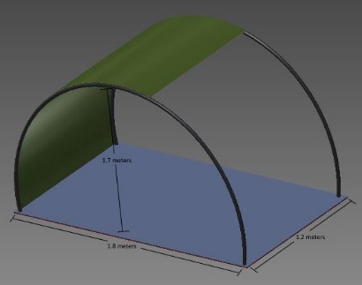
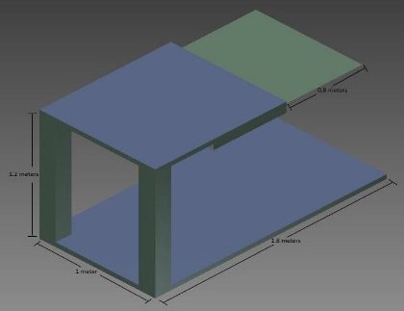
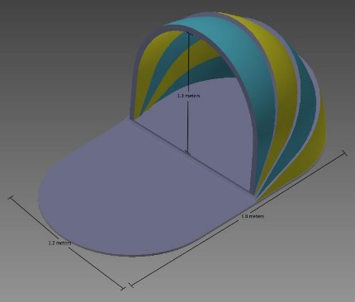
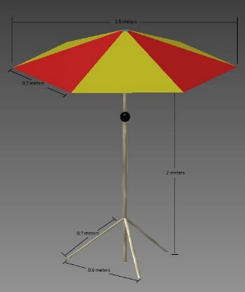
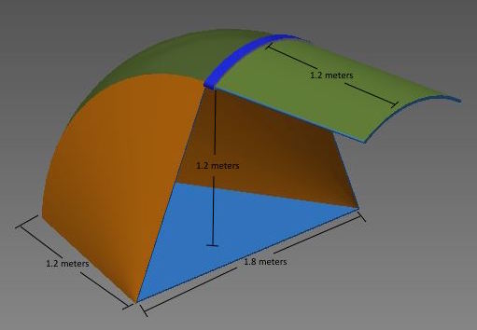
Mechanical Design
Specification | Ideal Choice
Portability | Easily Portable
Ease of Setup | Low setup requirements
Ability to cover 2 adults | Fully Cover 2 Adults
Exceeds minimum height | Size able to comfortably accommodate users
Ease of solar panel attachment | High ease of attachment
Wind resistance | High Wind Resistance
Protection from rain | High Protection from Rain
Use on all terrains | High usability in all terrains
Canopy
U-Shaped
Pop-Up
Cave
Umbrella
Notes:
Portability ensures that the device is able to be easily collapsible and lightweight so that it remains below the weight restrictions.
Ease of setup ensures the device can be set up under the 5 min specification.
Ability to cover 2 adults must be high as that was an initial design requirement
The minimum height of 1.2m found through calculations of a reclining human in a chair earlier must be exceeded for the device to be able to easily accommodate someone.
The power source must be able to be easily attached to the device.
The device itself should be able to withstand environmental factors of wind and rain and should be able to be used on all terrains.

Slide 22
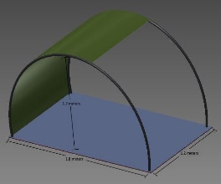
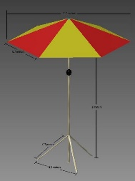
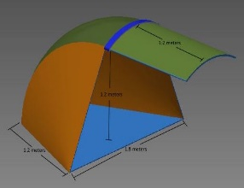
Accommodates Power Source Best
Highest Portability
Canopy
U-Shaped
Umbrella
Canopy
Easiest Set-Up
Best Wind Resistance
Pop-Up
Canopy
Canopy
Pop-Up
Covers 2 Adults Best
Best Rain Protection
Canopy
Cave
Cave
Canopy
Meets minimum height best
Best on all terrains
Canopy
Umbrella
Canopy
Cave
Notes:
Highest portability – The canopy shelter was found to have the highest portability with the fewest components. The U-shaped was second with relatively few components as well.
Easiest to set up- The pop-up shape consists of unrolling the base and popping up the shade giving it the most straightforward set-up. The canopy set-up would require the shade to be slipped onto two poles and placing the poles into the corners of the base which also leads to a fairly quick set-up time.
All 5 designs have room for 2 adults, The canopy and cave were chosen to accomplish the task of guaranteeing coverage of the entire bodies of two adults better than the others.
The canopy and umbrella both exceed the minimum height requirement of 1.12m and scored the best due to the light-weight and collapsible nature of the frames of both devices eliminating size restrictions.
Both the umbrella and the and the canopy have upward facing surfaces which would allow for best attachment of the solar panel for maximal power production.
All designs received the same wind resistance rating as all designs with proper attachments and weights should be able to withstand the wind. Canopy and Pop-up are shown as examples.
The cave having 3 of four sides covered along with an extendable portion was found to provide the best rain protection followed by the canopy design which has overhead protection as well as attachable sides to provide greater protection if necessary.
The cave was the best for all terrain due to the ability of accommating guy ropes for extra security if necessary along with stakes and sand bags (depending on terrain). The canopy was second due to its inability to support guy ropes.

Slide 23
MECHANICAL DESIGN PUGH CHART
 | Weight | Canopy | Extendable Cave | Umbrella Stand | Square/U Shape | Pop-Up
Portability | 8 | 8 | 8 | 5 | 7 | 7
Ease of Setup | 7 | 7 | 6 | 7 | 8 | 9
Ability to cover 2 adults | 9 | 10 | 9 | 8 | 9 | 7
Exceeds minimum height | 8 | 10 | 9 | 10 | 7 | 6
Ease of solar panel attachment | 7 | 8 | 7 | 9 | 8 | 5
Wind resistance | 6 | 7 | 7 | 7 | 7 | 7
Protection from rain | 6 | 8 | 9 | 6 | 8 | 6
Use on all terrains | 7 | 8 | 9 | 6 | 8 | 8
Weighted Score | 580 | 485 | 467 | 409 | 445 | 399
Normalized Score |  | 0.836 | 0.805 | 0.639 | 0.767 | 0.688

Slide 24
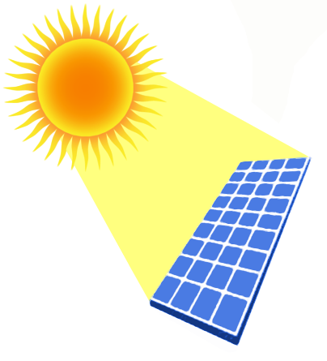
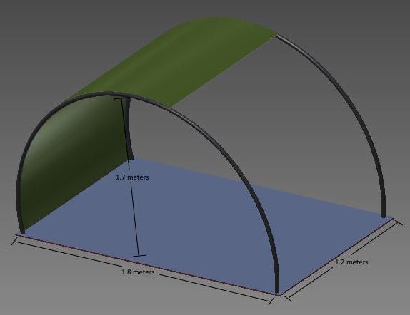
Overview of Chosen Design
POLYESTER
SOLAR PANEL W/RECHARGEABLE BATTERY
CANOPY
UNFIXED LIGHT SENSOR

Slide 25
Moving Forward
Step 1
Step 2
Step 3
Physical Embodiment
Arduino Code Creation
Order Materials
Create Materials List & Budget
Safety Analysis (Design-Safe)
Finalize Design

Slide 26
Acknowledgements
Team members Molly Shay and Kelsey Lipman for collaborating throughout the design process.
Dr. Frank Yin for the opportunity to work on and develop this project idea.
Professor Silva and the TA Joseph Humphries for answering any questions or doubts throughout the process.

Slide 27
QUESTIONS?

